Slide 1


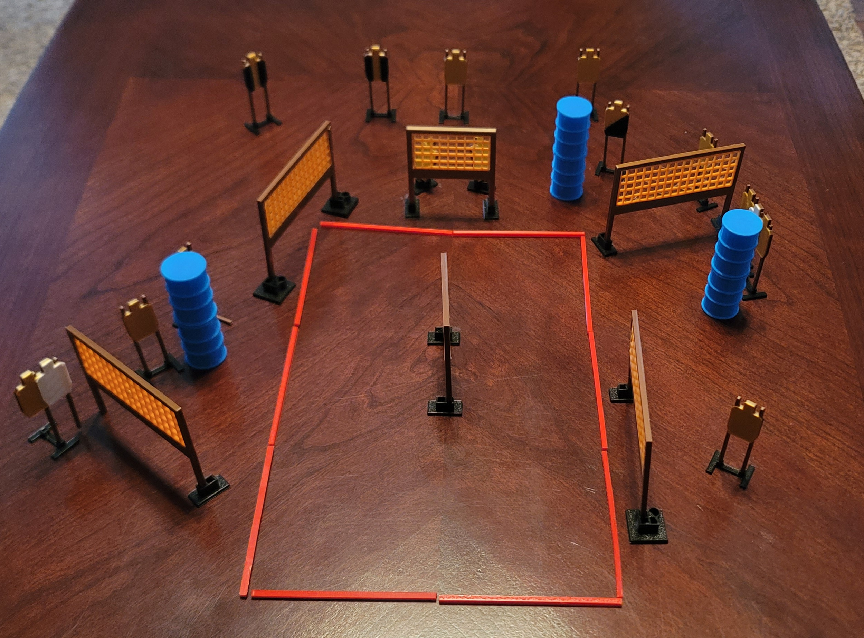
 | Dothan Gun Club – USPSA Match Round Hole, Square Peg Course Designer : Eric Henwood Bay: 9
Round Count 30 rounds 15 USPSA
Equipment List 12 wall feet 2 tux, 1 right diag 15 targets (12 + 3 NS)

Slide 2
Round Hole, Square Peg
Written Stage Briefing
Scoring: Comstock Rounds: 30
Targets: 15 USPSA
Handgun start position: toes on X’s, wrists above shoulders. Handgun is loaded and holstered.
PCC start position: toes on X’s, stock on belt. Loaded carbine is held with both hands, pointed at cone.
Stage Procedure: on the audible start signal, engage targets as they become available from within the shooting area.

